Slide 1
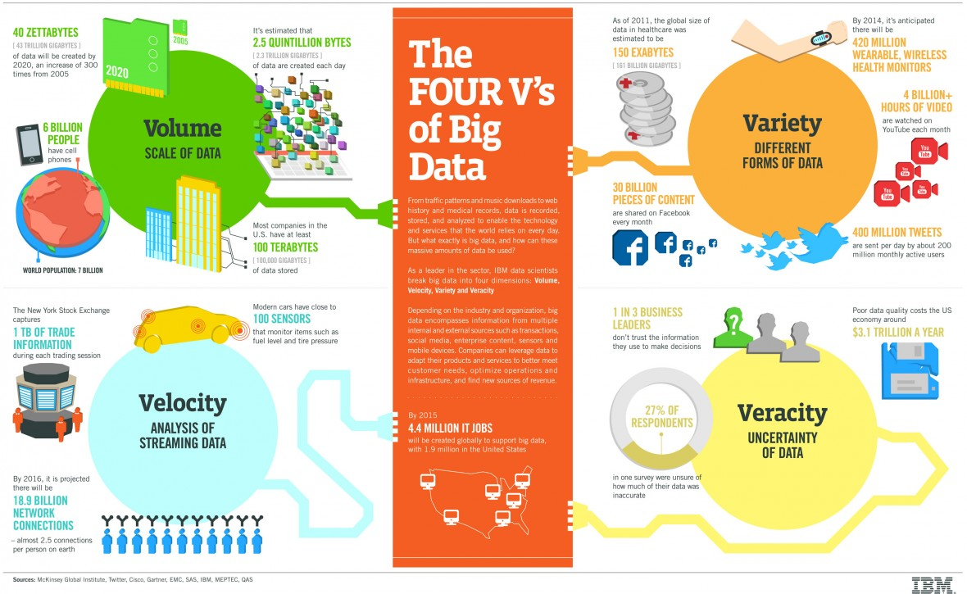

Slide 2
The Data Product
Combination of data with statistical algorithms that are used for inference or prediction. Created with data science workflows, specifically through the application of models, usually predictive or inferential.
Examples:
Amazon recommendations: Amazon examines the products you’ve purchased, and based on similar purchase behavior of other users, makes recommendations. In this case, order history data is combined with recommendation algorithms to make predictions about what you might purchase in the future.
Facebook’s “people you may know”: this product “shows you people based on mutual friends, work, and education information... [and] many other factors”. Uses the combination of social network data with graph algorithms to infer members of communities.
Source: Data Analytics with Hadoop, Bengfort & Kim

Slide 3
Data Lake
“Store it all in one place, figure out what to do with it later”
Won't get any value out of that data until you figure out the logical structure for it
Better keep track of your metadata one way or another

Slide 4
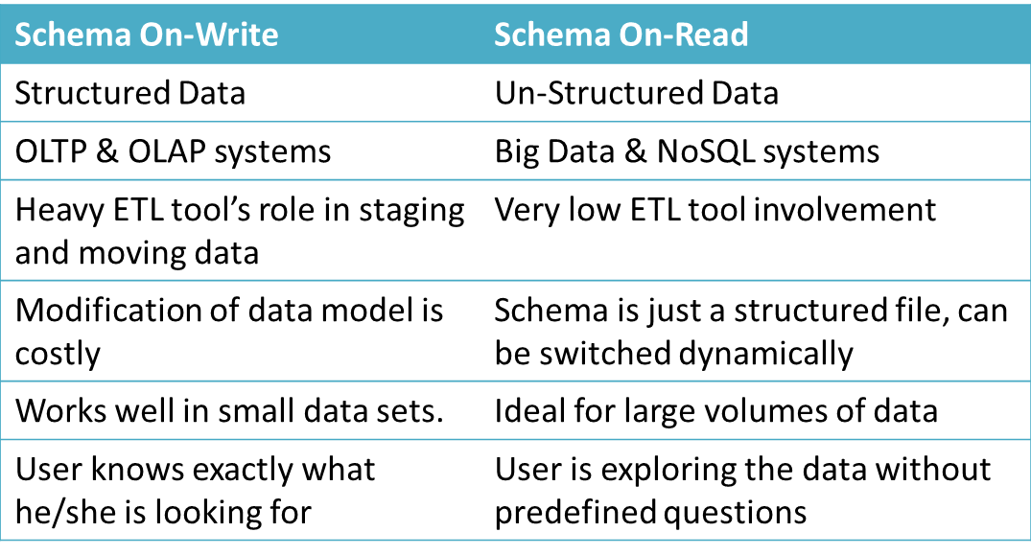

Slide 5
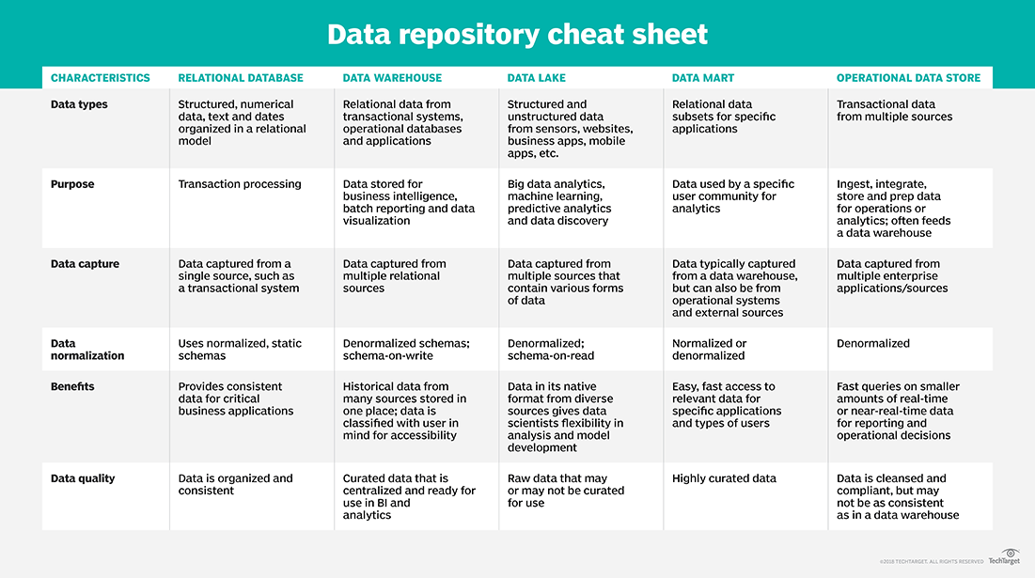

Slide 6
How to Handle Large Data Sets? Big Data Infrastructure Comes to Rescue
Big Data Problem was first faced by Google
Indexing the whole world’s webpages
Ever-growing amount of data & very high storage/processing cost
New data types (text, image, video…)
Idea:
Divide-and-Conquer, Moving computation to data
On scalable, cheap commodity machines
schema-on-read, rather than schema-on-write
Technology: Hadoop Ecosystems
Hadoop File Systems-HDFS (Storage)/MapReduce (Processsing)
Applications: Hive/Pig/Oozie, etc. (and still evolving!)

Slide 7
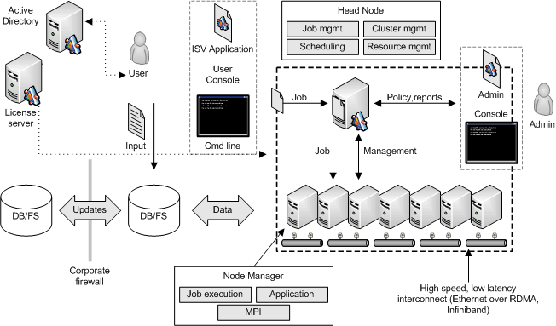
Cluster Computing
A set of loosely or tightly connected computers that work together that can be viewed as a single system
Source: https://msdn.microsoft.com/en-us/library/bb524833(v=vs.85).aspx

Slide 8
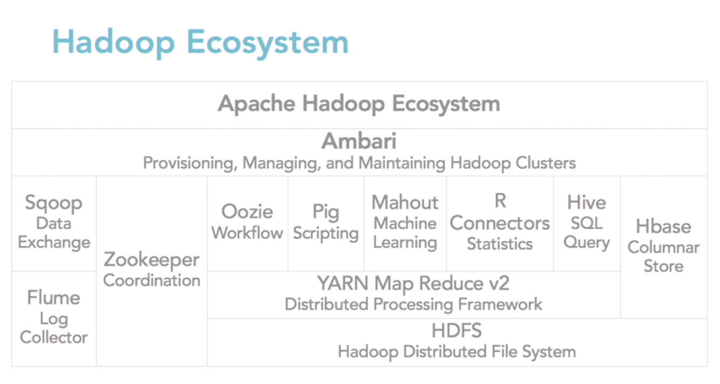

Slide 9
Application 1: Count the Number of Each Symbol
Three Stages

Slide 10
Spark
Apache Spark
Open source data processing engine for big data sets
Spark splits up large tasks across different nodes. However, it tends to perform faster than Hadoop and it uses random access memory (RAM) to cache and process data instead of a file system. This enables Spark to handle use cases that Hadoop cannot.
Benefits of the Spark framework include the following:
A unified engine that supports SQL queries, streaming data, machine learning (ML) and graph processing
Can be 100x faster than Hadoop for smaller workloads via in-memory processing, disk data storage, etc.
APIs designed for ease of use when manipulating semi-structured data and transforming data

Slide 11
Hadoop’s Future
Deployment Experience and Hadoop Vendor Consolidation Are Causing Organizations to Reevaluate Hadoop’s Role
Hadoop projects have often been undertaken with unrealistic expectations, and failures resulted. Gartner clients have described plans to replace broad, complex suites of jobs running against large, optimized data warehouses by “moving it to Hadoop.” Not surprisingly, many of these projects have not succeeded.
But Hadoop is not a single thing. It is a collection of parts, and it should not be equated simply with MapReduce batch computing, or with Hadoop Distributed File System (HDFS) data storage, as it often is.
Batch processing use cases, often for basic extraction, transformation and loading (ETL), are a shrinking percentage of deployments, as interactive processing, data enrichment and data science use cases are more frequently considered for the data for which Hadoop is typically used. Components dramatically extend the value proposition of Hadoop, such as:
Apache Spark for interactive computation
Apache Hive for analytic use cases
Apache HBase for persisting data for operational use cases
Apache Atlas for its broad governance and policy capabilities across use cases and data sources
Source: Choosing the Right Path When Exploring Hadoop’s Future, Gartner Group 3 August 2021

